Slide 1
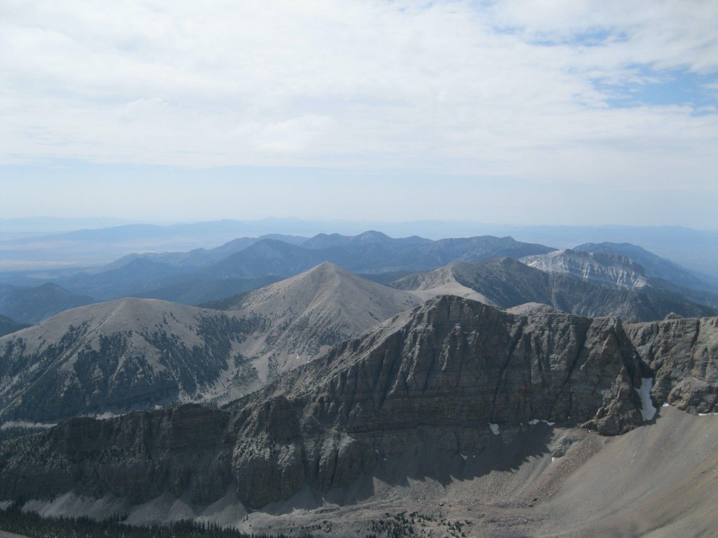
Synextensional magmatism in the Basin and Range Province; A was study from the eastern Great Basin
gans et al., 1989
Presented by Luke J Schranz

Slide 2
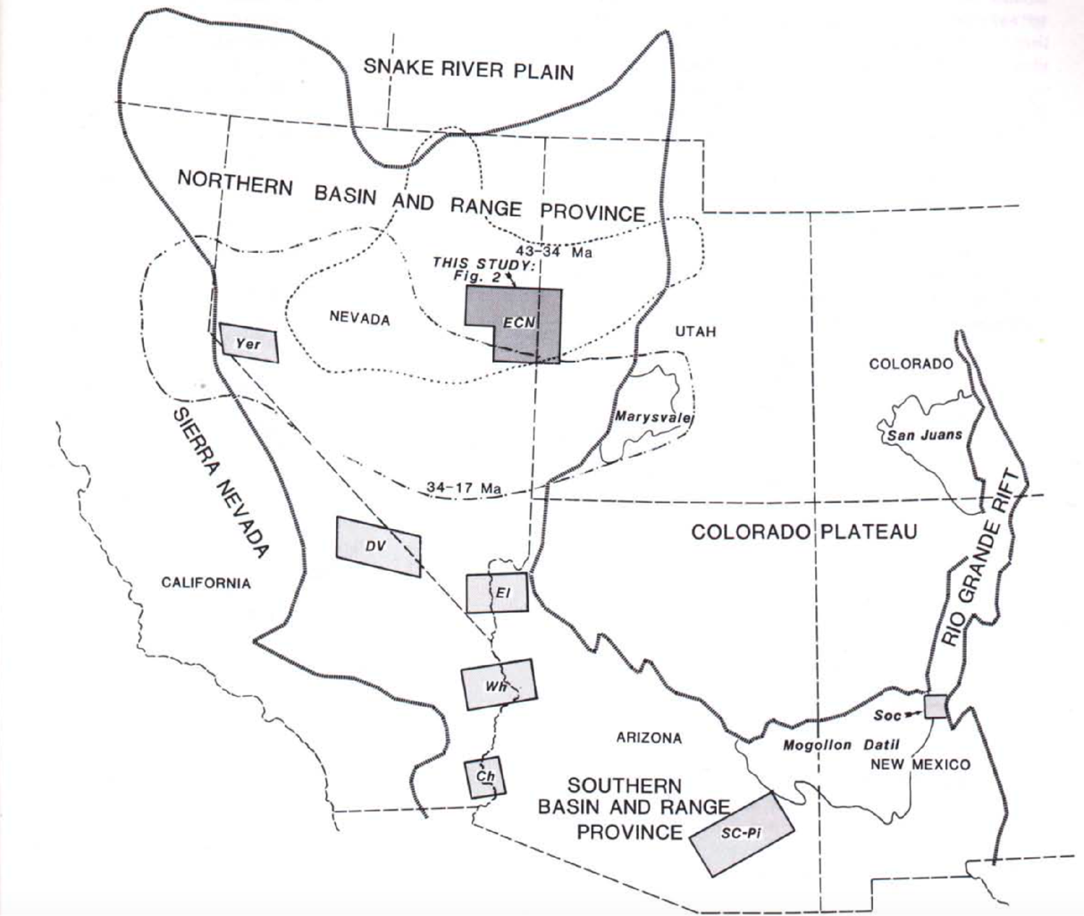

Slide 3
Motivation for this study
Southward sweeping Tertiary volcanism is parallel to continental margin
Tertiary “arc” (~900km) much wider than modern arcs (~300km)
Extension predated subduction across much of the Great Basin
Calc-alkaline to bi-modal “switch” in Tertiary, is much oversimplified and has no relation to position of Mendocino Triple Junction

Slide 4
Takeaways from this study’s observations
Large flux of basaltic magmatism into crust hybridized with crustal partial melts
Thermal weakening of the crust caused failure resulting in extension once magma accumulated at shallow crustal levels
Dacitic-andesitic to basaltic volcanism transition as crust thinned and cooled

Slide 5
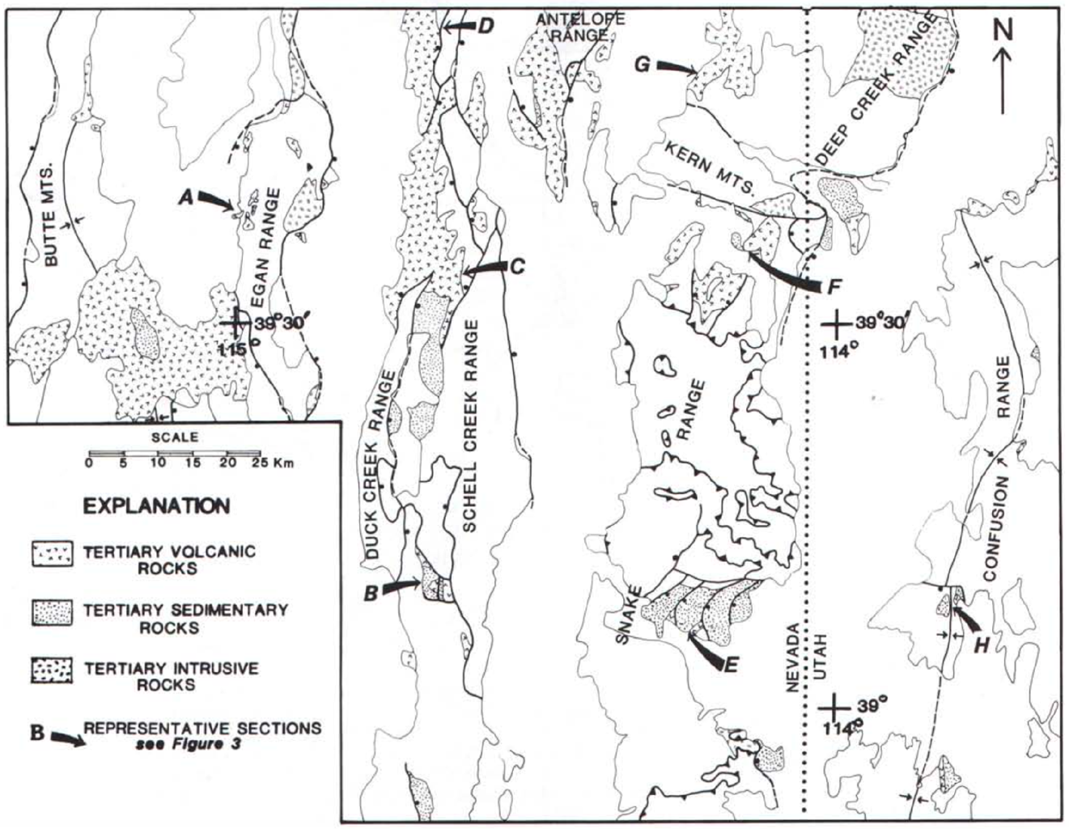

Slide 6
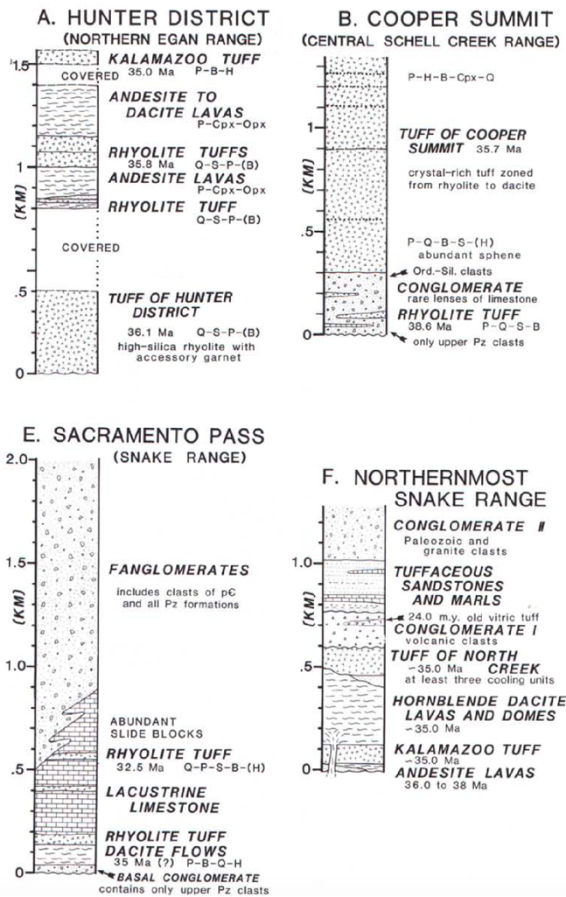
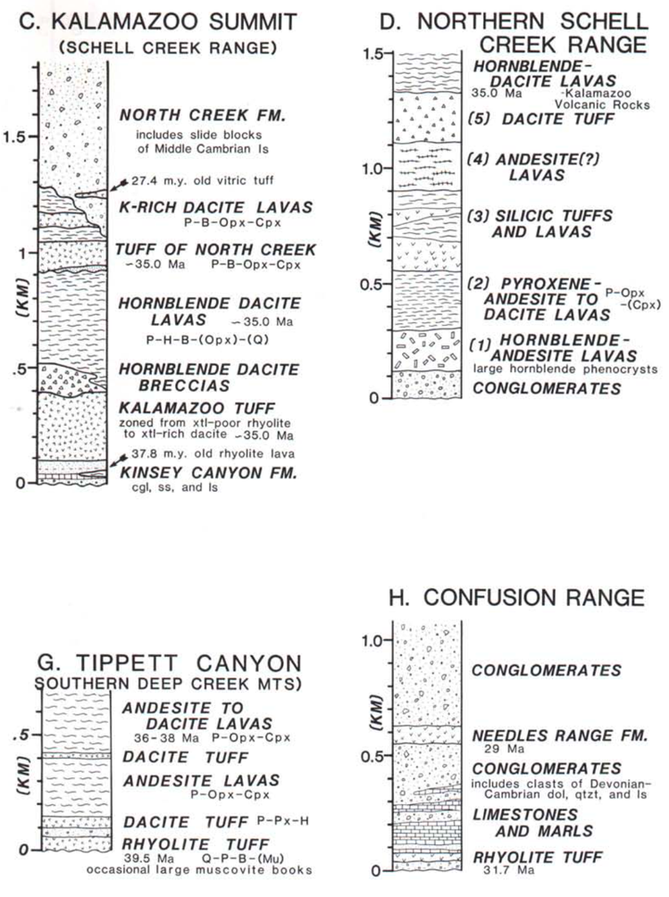

Slide 7
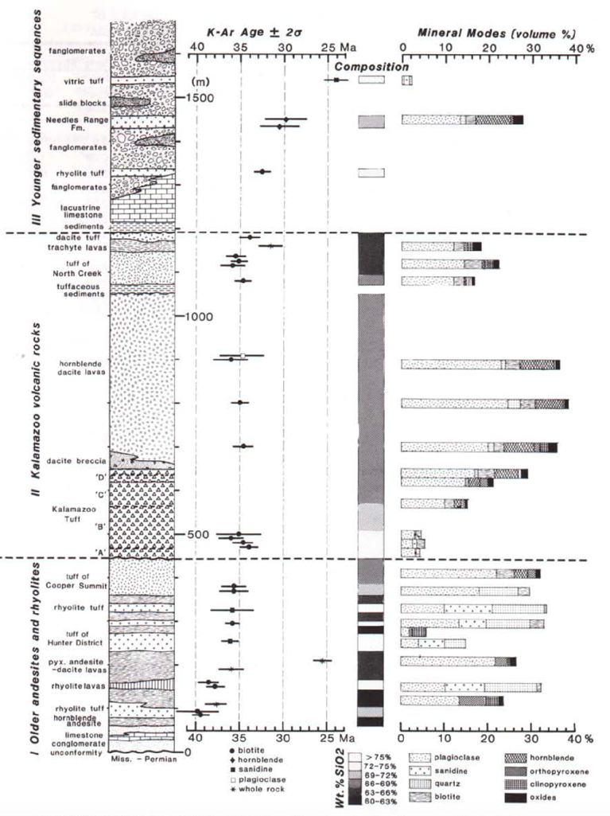

Slide 8
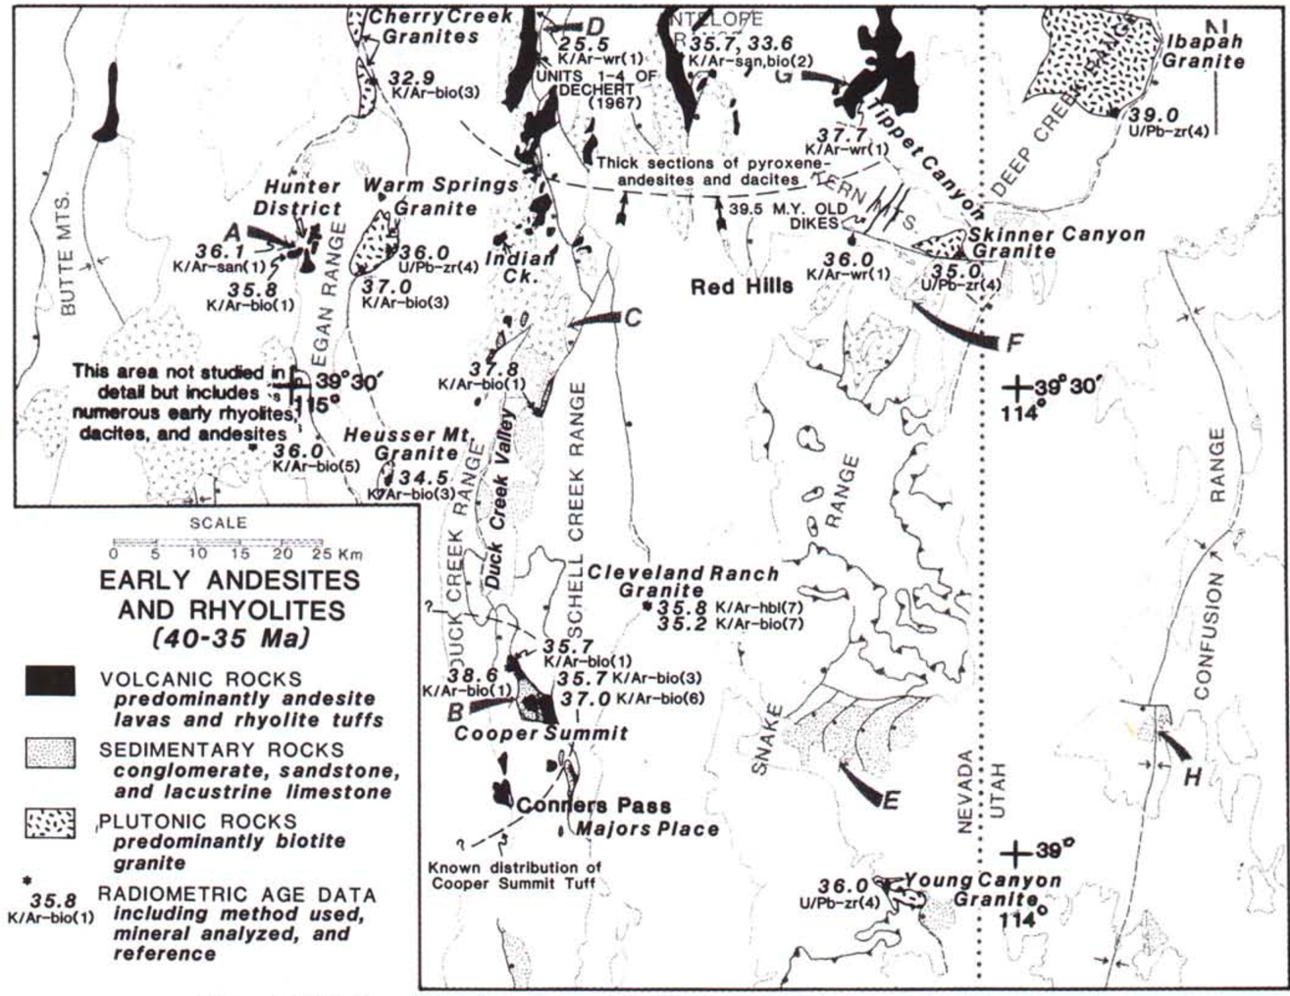

Slide 9
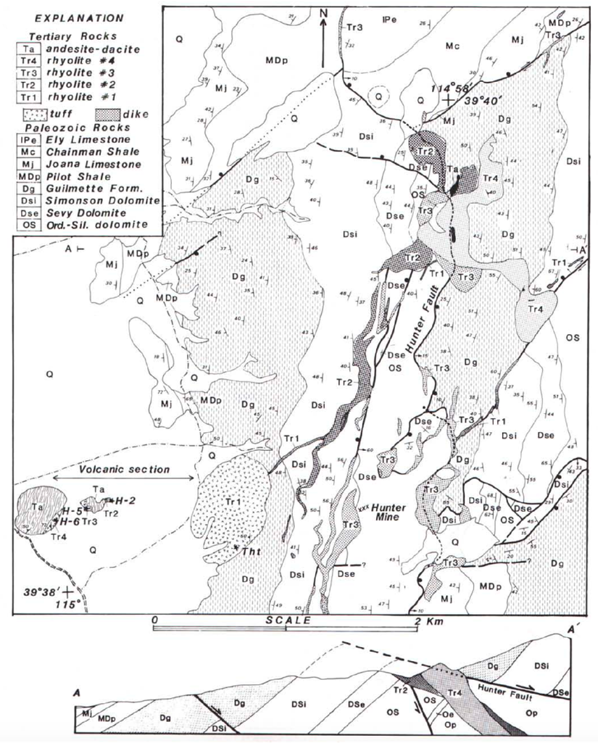
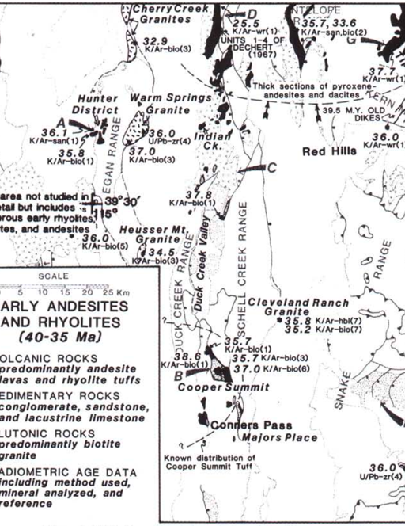
Hunter District Egan Range

Slide 10
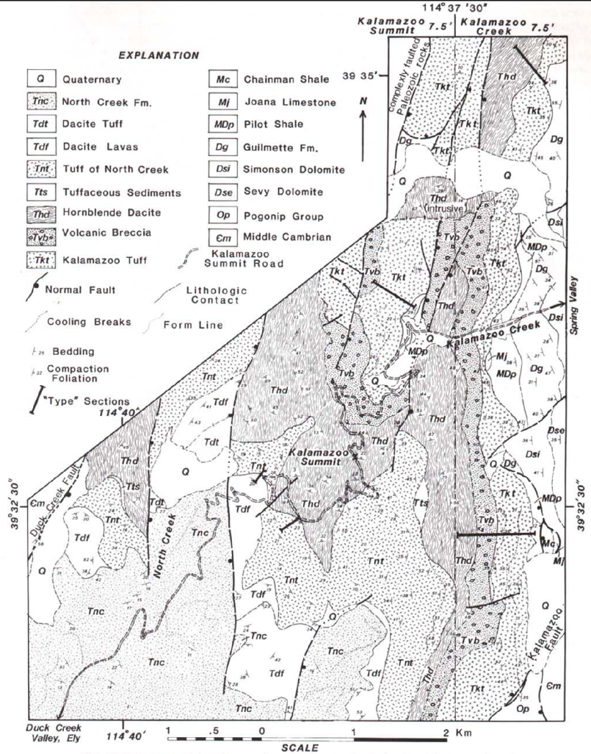

Slide 11
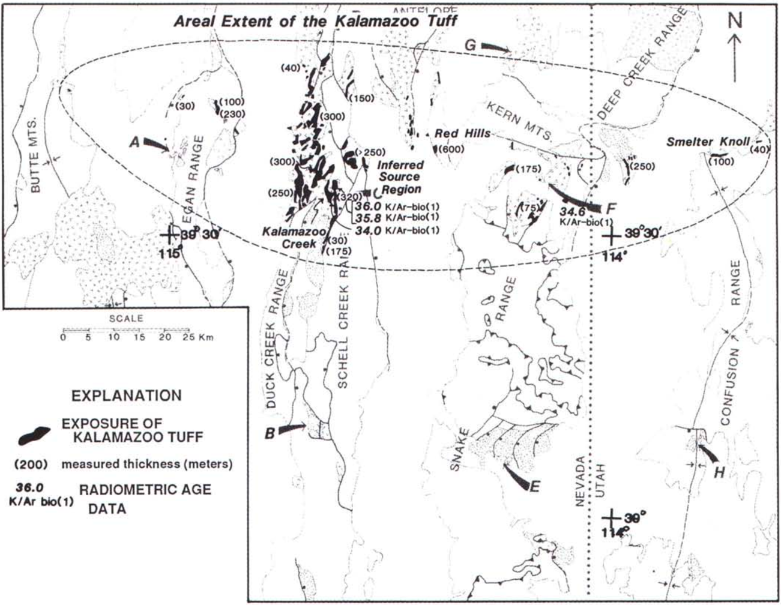

Slide 12
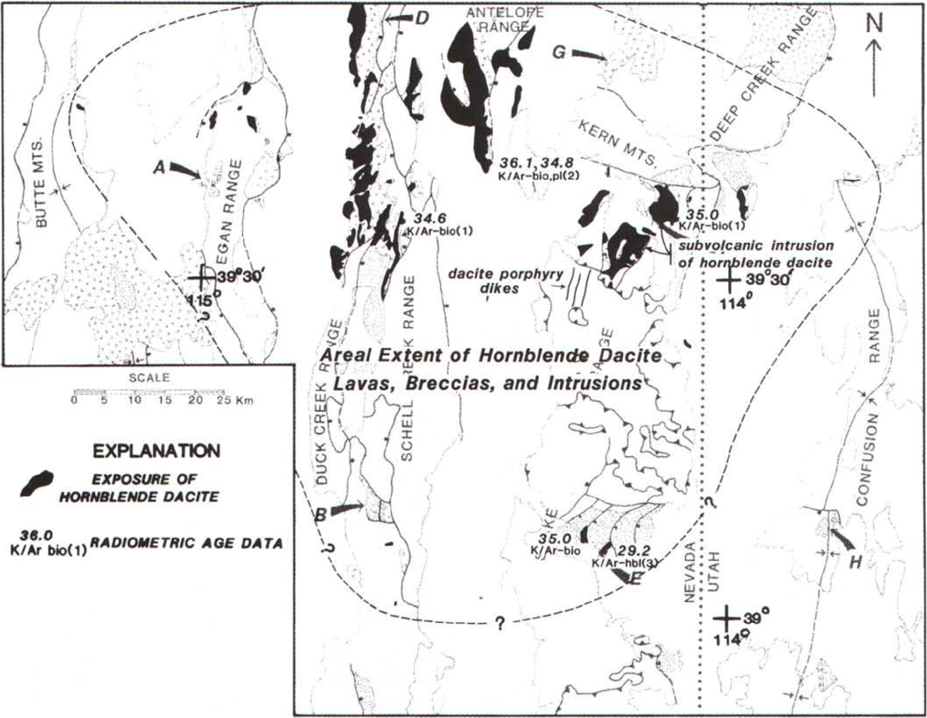

Slide 13
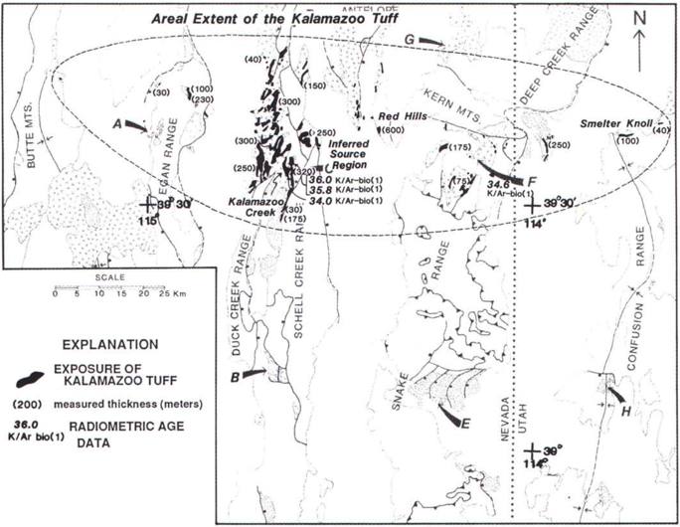
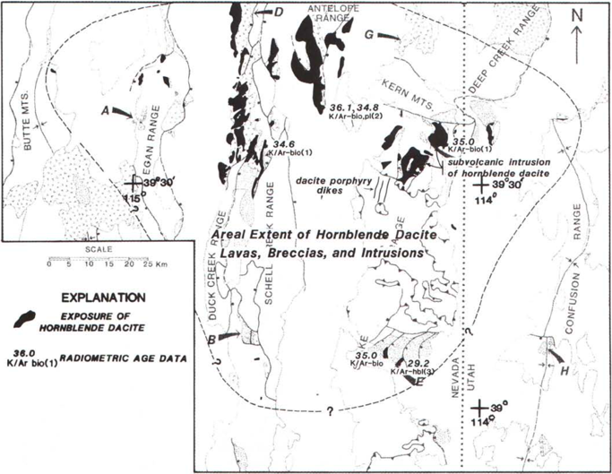
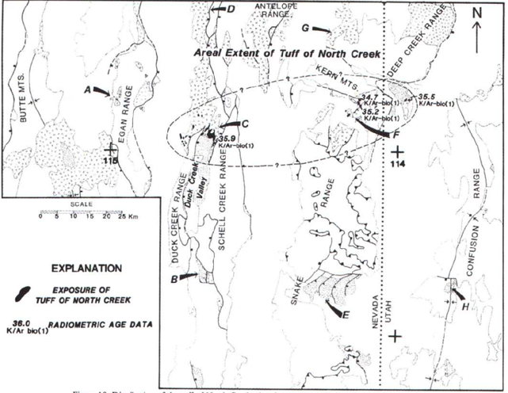

Slide 14
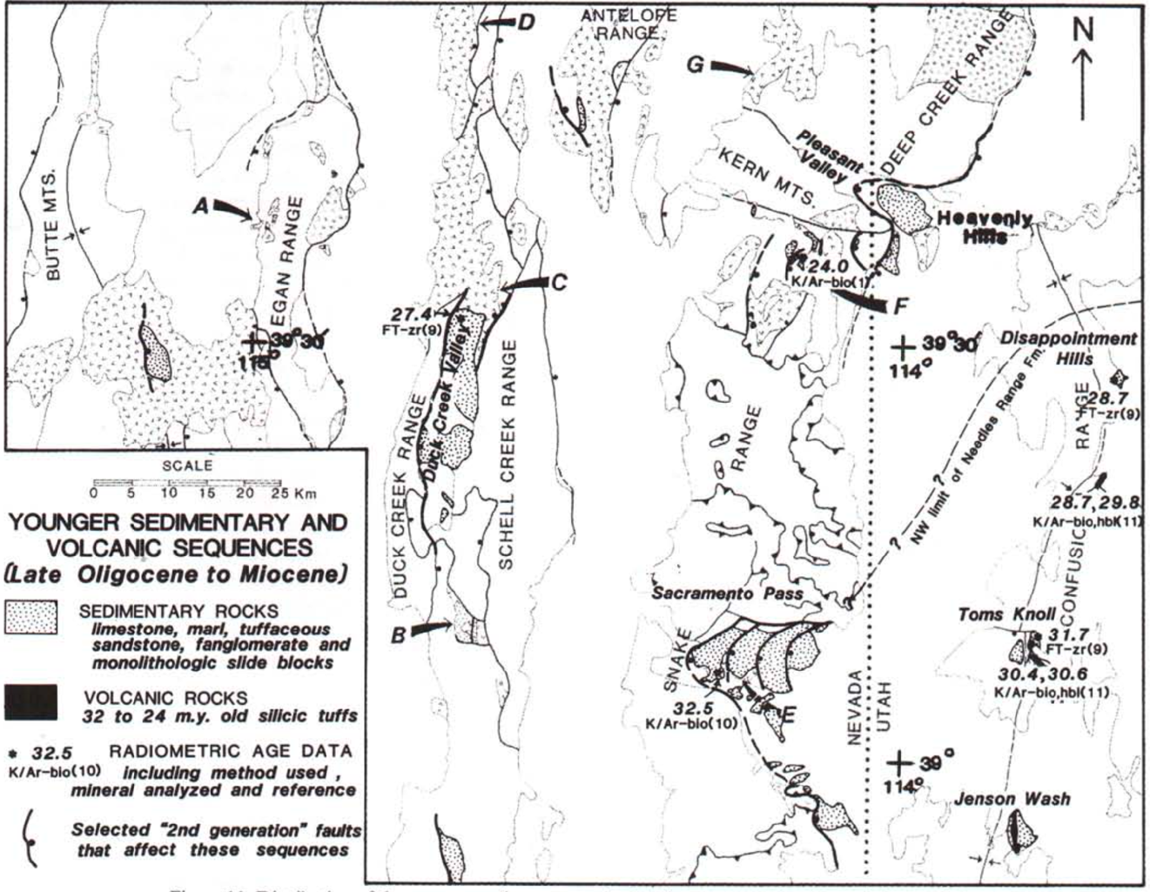

Slide 15
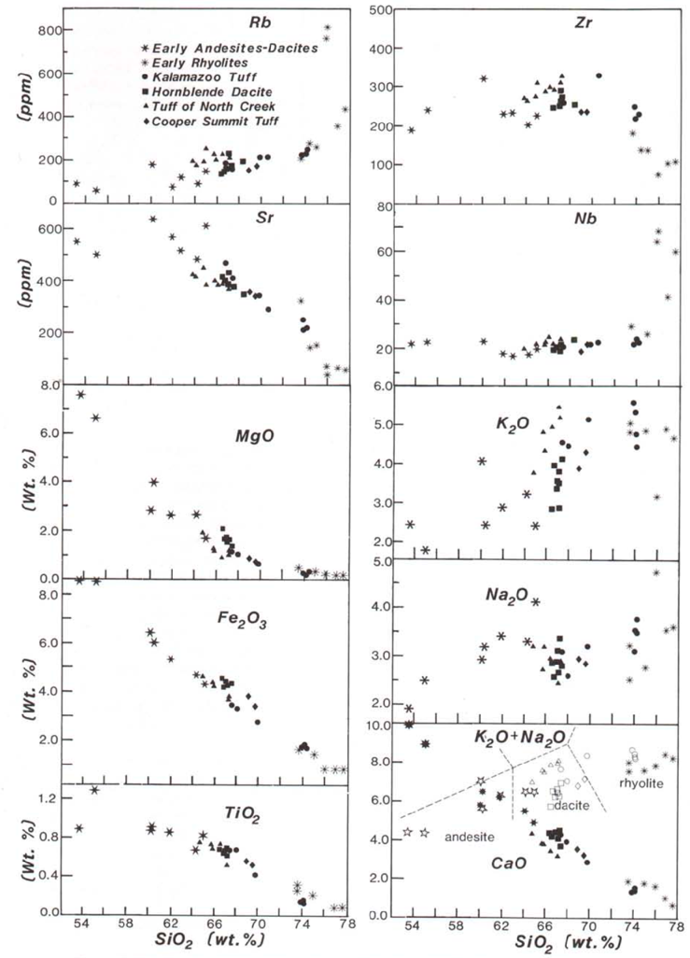
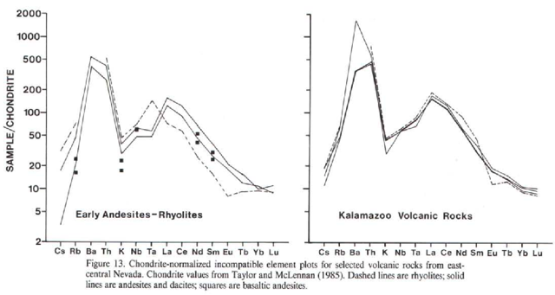
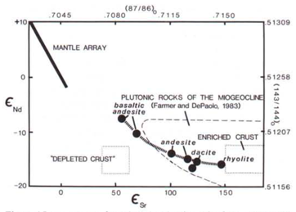
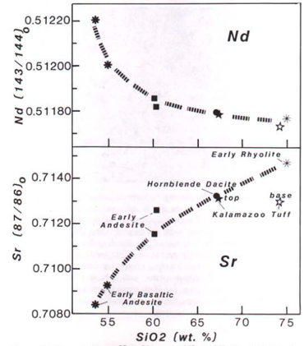

Slide 16
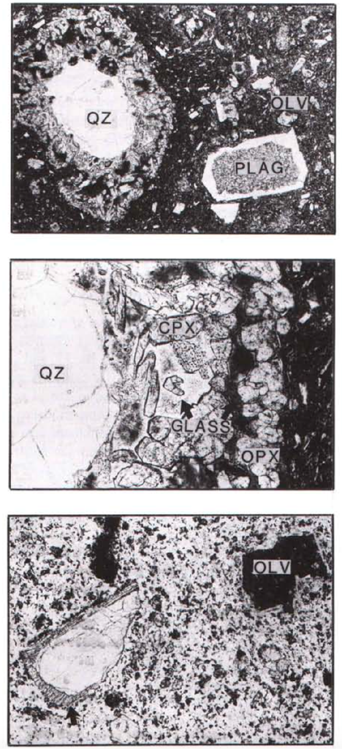
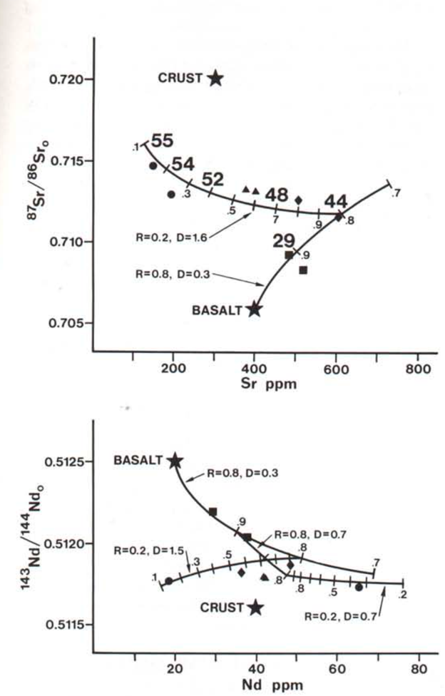

Slide 17
Hunter District Egan Range

Slide 18
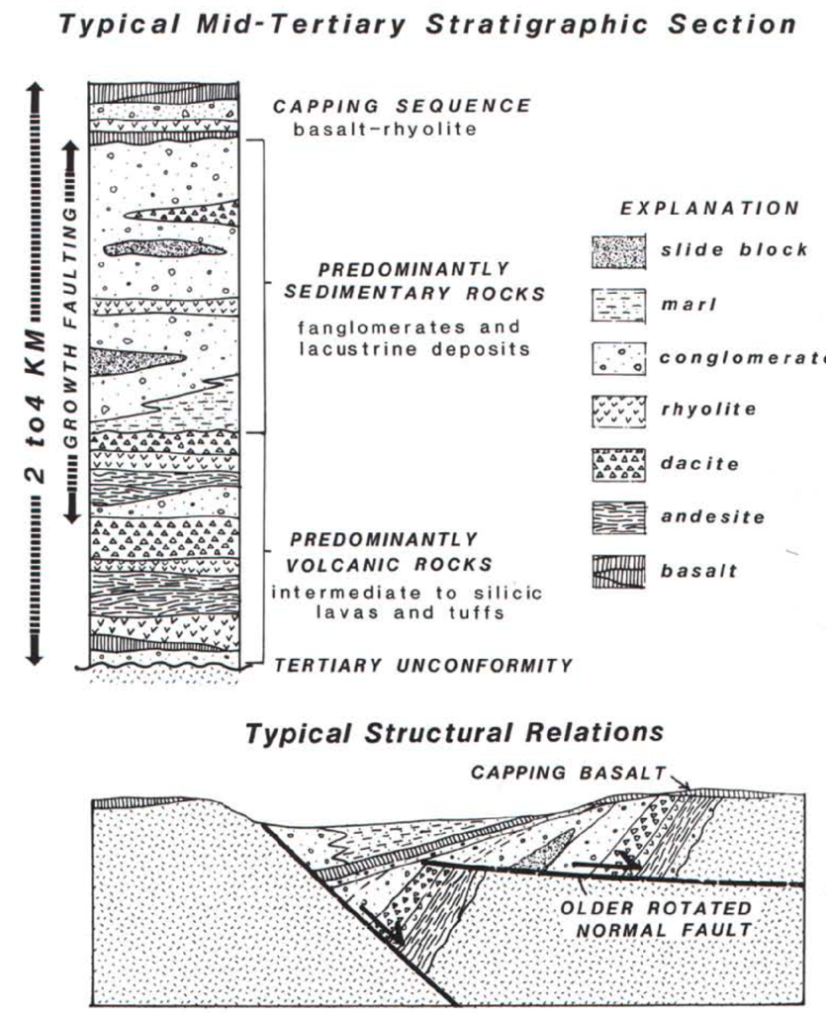

Slide 19
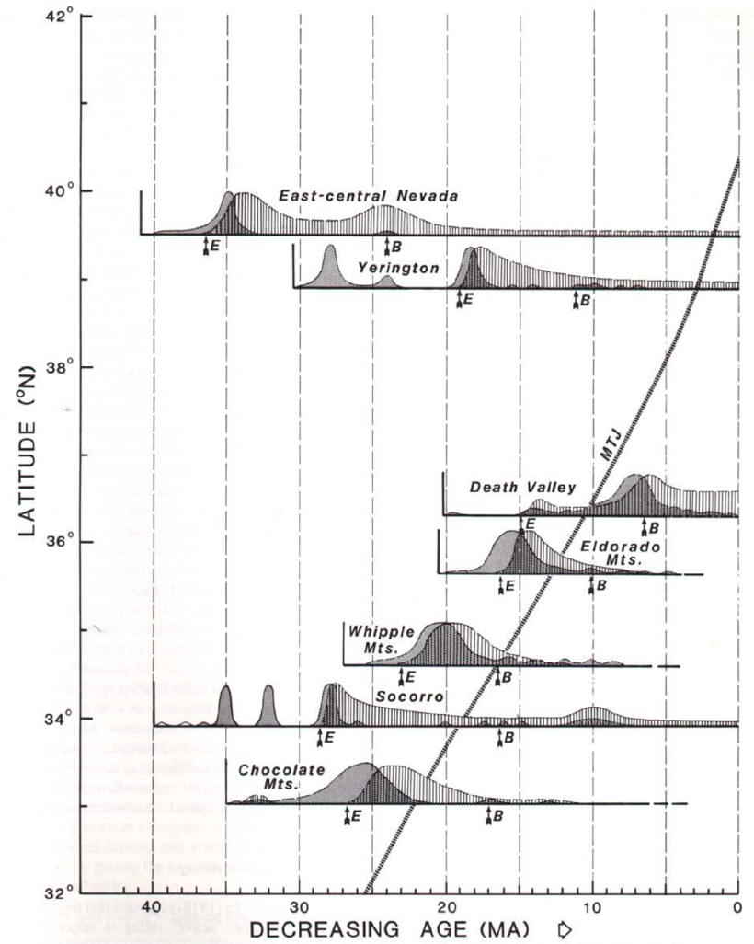

Slide 20
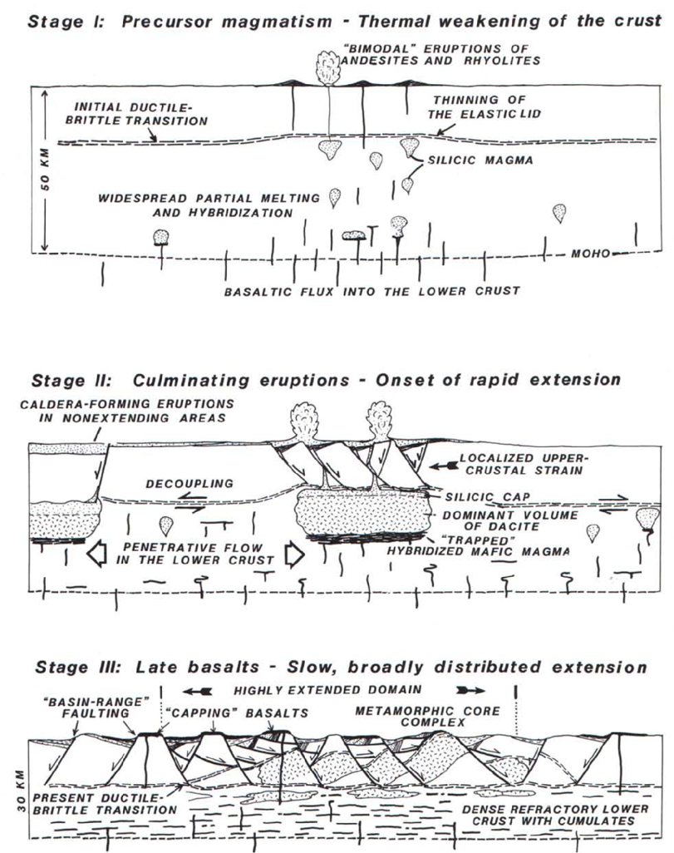

Slide 21
Motivation for this study
Relaxation in compression causing extension in backarc or gravitation collapse due to overthickening?
Southward sweeping Tertiary volcanism is parallel to continental margin
Tertiary “arc” (~900km) much wider than modern arcs (~300km)
Extension predated subduction across much of the Great Basin
Calc-alkaline to bi-modal “switch” in Tertiary, is much oversimplified and has no relation to position of Mendocino Triple Junction

Slide 22
Relaxation in compression causing extension in backarc or gravitation collapse due to overthickening?
Volcanism in Great Basin predates MTJ passage
Glazner and Bartley 1984 model on faulting, volcanism, and MTJ relation: “Our principal objection to their model is that it addresses only a restricted part of the southern Basin and Range province and fails to explain similarly transgressive magmatic and extensional histories elsewhere in the province.”
Distribution of Cenozoic extension and magmatism far less related to Mesozoic shortening it is to Cenozoic plate motions
Elevated thermal conditions (Eocene) established during shortening
Extension fluxed by Mantle derived basalts
“Onset of rapid, large magnitude extension, … was triggered by a pulse of basaltic magmatism”

Slide 23
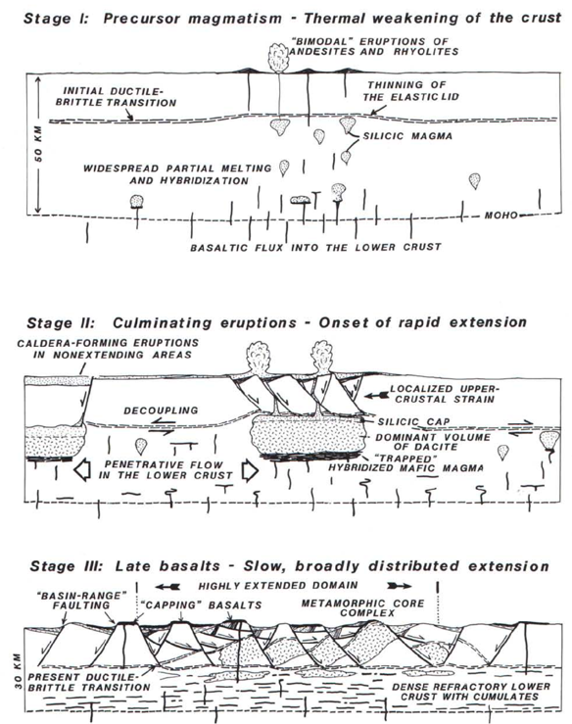
“The model here revives the old, currently unfashionable idea that supracrustal extensional faulting in the Basin and Range province was largely a response to deep-seated intrusion.”
Cenozoic extension and volcanism were intimately related to and triggered by an active flux of basaltic magma into the crust

